Slide 1
QA – Ad-Hoc Testing Guidelines
September 2009

Slide 2

What is ‘Ad-Hoc Testing’?
‘Ad-hoc Testing’ is a test method which is carried out using no particular recognised test case design technique.
It is the least formal method of testing but this does not mean “Cowboy” approach.

Slide 3
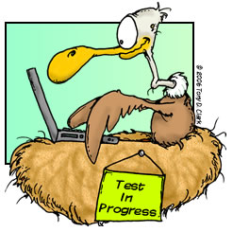
You don’t have to be a tester to do Ad-hoc testing
If you can....
travel on different tracks and conduct use-case scenarios to what has been originally specified.
be relentless and critical about both your work or others.
be investigative.
anticipate a users actions.
If you....
have a “What If / curious” mindset.
like to explore different approaches.
Then chances are, you already do this.

Slide 4
What are the Benefits?
Ad-hoc testing helps testers to learn the application/functionality prior to commencing any formal testing.
Reading the requirements or specifications (if they exist) rarely gives you a good sense of how a piece of functionality actually behaves.
The user documentation may not capture the “look and feel” of a piece of functionality. This is essential when testing a product dependent on a good user experience
Defects found while conducting ‘ad-hoc testing’ are often examples of entire classes of forgotten test cases or requirements/specification
Functional test cases derived from requirements stop yielding defects after few builds or test cycles. Using the ‘Ad Hoc’ method, the tester can test functionality relying on skill and intuition, accompanied by their experience and exposure to other similar/previous test candidates.

Slide 5
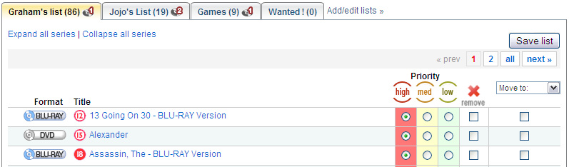
Example
In a previous slide we mentioned that “you can test functionality relying on skill and intuition”
‘Ad-Hoc’ is unplanned but there still needs to be some theoretical planning behind the approach. Lets look at an example:
Below we have a snippet from the rental list. A typical test could be...
Set ‘Alexander’ to a ‘medium’ priority?
By clicking the ‘medium’ bullet option on the row of ‘Alexander’ this would start the process, but What if I clicked ‘Save List’ or ‘Remove’ against another title whilst the action was still being performed? Is it possible the user can do this? If so, what happens?
This approach may then open up a raft of questions to the design.
Should the list be disabled to prevent interaction whilst an operation is in progress?
Should the list simply handle the request / operation simultaneously?
These are all fundamental questions that if not asked during the design phase, will likely produce a bug or error.

Slide 6

Isn’t the answer simply, “As Designed”?
“A common recipe for personal growth is to start with what you have,
identify what sucks about it, and try to make it ‘suck’ less. Software
developers call this ‘fixing bugs’.”
- Brad Bollenbach - 30 sleeps (Open Source Personal Development)
“A common recipe for improving the quality of LoveFilm's software is to start with the requirements,
identify what sucks about them, and try to make them ‘suck’ less. Testers (I) call this ‘”Probing the possible
actions of the user”.
- Graham Boulton - LOVEFiLM

Slide 7
Ad-Hoc Testing Upfront
So... You have finished your code that ‘allows a user to modify a rental list priority’ and its ready to go into QA.
What can you do to help ensure that no bugs are found during the testing phase?
Start by...
Thinking about how the user may interact with the options they have in front of them (how they might prioritise their rental list). Put yourself in the mindset of a paying customer who expects ‘Everything!’ to work perfectly.
There are many different types of users, some of which are fast at interacting with on-screen objects; so look at:
Potential impact on refresh issues
Simultaneous conflict (objects interacted at the same time sharing the same code or variables)
Multiple clicking the same on-screen objects (There are a lot of impatient users out there)
IMPORTANT ! Do not assume that a customer or user will know the work around to a problem you are aware of. It’s still a bug ! Even if it is “Browser specific”

Slide 8

Is there really that much to test using the Ad-Hoc approach?
The simple answer is YES !
There is a reason why Microsoft relies on BETA testing by the general public. The permutations are huge. Lets just look at a tiny aspect of the rental list page and identify some permutations.
A single tab on the rental list
Possible test items include:
Can the title accommodate unusual characters such as ‘hyphens’ or ‘apostrophes’ (These can cause issues with SQL queries)?
Does the number on the tab represent the correct number of movie rentals that reside beneath it?
Is the number representing the quantity of disc allocations to this list correct?
What happens when a user clicks on the name within the tab versus the tab itself?
What happens when a user clicks and drags the tab on screen, potentially by accident?
Is the user able to copy and paste the text of the tab to the windows clipboard? If so, should this be permitted?

Slide 9
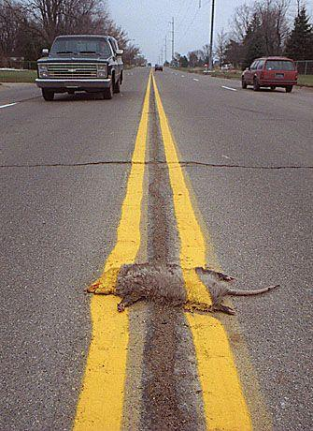
Why not just leave it to QA? Isn’t that their job?
NO ! There are major benefits to developers and others performing Ad-hoc tests. For example:
Bugs developers find before they check in are cheap to fix (no red tape)
Bugs that developers find, may be a symptom of a larger issue that will radically affect their design or implementation
Every bug a developer finds and fixes is a bug a tester doesn't have to waste time finding and reporting
Winner of the
“Not My Job”
award

Slide 10
Ad-Hoc Standards
Where to Begin...
Before starting on your ‘Ad-hoc’ journey you need to forget about how the piece or area of functionality (that you may have been working on) has been developed.
Ask yourself “As a user, what is my ‘end goal’. What do I want to achieve when I venture down the applicable area of functionality. Lets use another example...
Change of a customer address on LOVEFiLM
In this ad-hoc scenario, the user has moved home and simply has 3 objectives in mind:
Log-in to the site
Change home address in the fastest way and be confident it has been achieved
Potentially check their rental list before logging out

Slide 11
Example: Change of Address: Step 1
Log-in
On this user journey the user will need to log-in to the site. From an Ad-hoc perspective you may want to think about the following steps:
Navigate to the LOVEFiLM log-in page
Enter Log-In information that is incorrect
Click ‘Forgot username/password’ and check email reminder works
Re-Enter a valid Log-in username and password
Finding where to change address
Click the ‘My Account’ link at the top of the page (Typically the user will use this as it is right at the top of the page and would be anticipated as the fastest way for the user to change their details)
Alternatively you can also try clicking the ‘Help’ link and conducting a dynamic search using text such as “How can I change my postal address?”

Slide 12
Example: Change of Address: Step 2
Changing Address
On the ‘My Account’ page there appears to be 2 different ways on how a user can change their address
Clicking ‘My Delivery Details’ on the left navigation bar
Clicking ‘Change’ next to ‘Shipping Address’ on the centre screen
Both of these methods could be tested in such a way where even an additional test can be performed which would validate whether a user is able to change their delivery address twice in succession. Remember that Ad-Hoc testing can open examples of entire classes of forgotten test cases or requirements/specification.
Postcode Lookup
The user now has the ability to use our postcode lookup feature. Therefore lets first see what happens when a single character is entered. What should the user see?
Try entering a valid postcode into the lookup field and click ‘Find Address’ without refreshing the screen first
Check to make sure the ‘Change’ button works after using a valid postcode
And finally, make sure that the valid address is found and the user can apply this

Slide 13
Example: Change of Address: Step 3
Logging Out via the Rental List
Confirming the address change on the ‘My Account’ screen the user is happy, however what are the chances of the user just logging out straight away?
Maybe they want to now change their payment method too
Maybe they want to view their rental list
Start an account holiday or change email address
All of the above are simply a small number of possible permutations for the remainder of the users journey
IMPORTANT:
Typically users are consistently driven by what is most prominent when they have no immediate objective (i.e. changing their address details). Things that will drive your Ad-hoc tests will likely be:
Images
Bold Text
Central Text or Eye Catching Text Content

Slide 14
The 2 Key Areas to ALWAYS consider
Functional
Navigational
User manually forcing refreshes on a page
Navigating through direct URLs (Copy/Pasting) and URL manipulation
Multiple Browsers
Multiple tabs active on the same LOVEFiLM account
Case sensitivity (Is CAPS lock left turned on, on the user machine)
Users may want to return to a single start point (e.g. Clicking on the ‘Home’ tab after each screen navigation)
Users can click multiple times on links which have not had time to refresh
Clicking a new link prior to a page completing its loading
Mouse over functionality and hovering text

Slide 15

In Summary
Ad-Hoc Testing <>

Slide 16
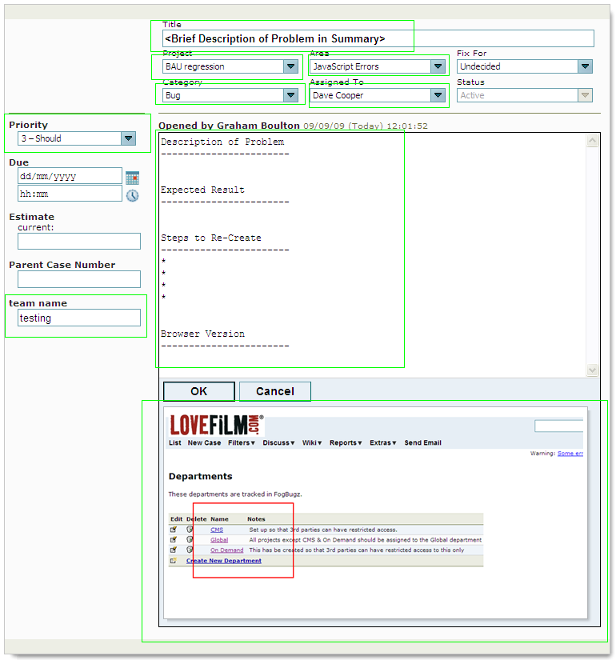
Raising a Bug in Fogbugz
Clear Title (Summary of the Problem)
Assign correct project
Select appropriate area
Category = Bug
Assign to the applicable individual
Set priority to an appropriate level
Critical = Nothing works !
Must = Major Functional problem with no workaround.
Should = Functional problem with a workaround.
Could = Ideally should be fixed but unlikely to cause contact.
Bug Content MUST include the following detail:
Description of the Problem
Expected Result
Clear ‘Steps to Reproduce’ the problem
Browser version (if specific to bug)
Screenshot

Slide 17
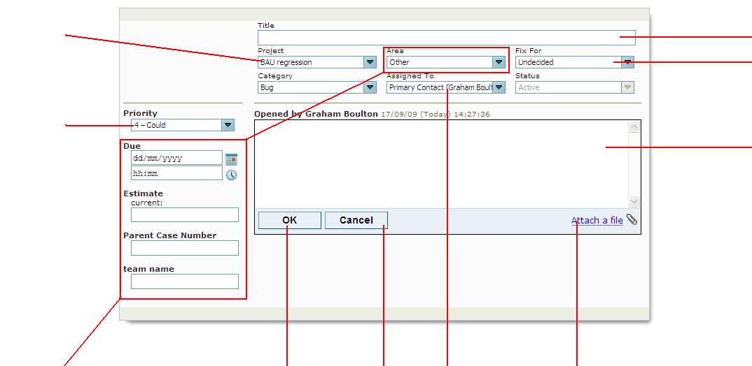
Raising a Bug in Fogbugz - Detail
Project: Set to the applicable project created in fogbugz
Title of Bug
Leave as ‘Undecided’ (Unless applicable)
Bug Priority: Use this drop-down to assign the priority required to fix this bug. The four options to choose from are:
Critical
Must
Should
Could
Bug Description: Describe here the bug and the problem. Please be accurate and ensure that you add and provide comments to the following headings:
Description of Problem
Describe problem in more detail
Expected Result
Describe what you would expect to see
Steps to Re-Create
Provide step by step instructions on how to re-create the bug/issue
Browser Version
State what browser you were using and its version
These fields are not necessary to be completed by the tester and are only used for planning purposes.
OK/Cancel to either submit the bug/case after completion or cancel.
Assign Case: Use this link drop-down to assign the bug to the assigned developer applicable to the defective piece of work
Attach File: Use this link to browse to a captured image on your machine and attach a screenshot of the error to the bug/case

Slide 18
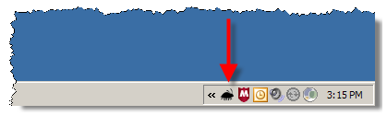
Need more help?
Talk to anyone in QA/Testing about how they approach their work
Ask QA/Testing to help you brainstorm test cases for your code
Refer to the article: http://www.scribd.com/doc/10029234/Ad-Hoc-Testing
This provides further information to Ad-hoc testing in more detail
Fogbugz URL: https://fogbugz.lovefilm.com
Fogbugz screenshots and cases easily generated by installing the fogbugz tool found at the following location: https://fogbugz.lovefilm.com/default.php?pg=pgScreenshotDownload
And remember...... Any good tester will jump at the chance to help their fellow developers test better

